Slide 1
Object Oriented Programming using Java (ECSE102L)

Slide 2
Outline
Loops
While Loop
Do-While Loop
For Loop
Nested Loop
Break and Continue in Loop

Slide 3
Loops
S
Loops can execute a set lines or statements as long as the specified condition is satisfied.
It mainly saves time.
There are mainly two types of loops:
  Definite loop: A loop that executes a finite number of times.
  Indefinite loop: A loop where it is difficult to determine in advance how many times it will be executed.

Slide 4
While Loop
S
In Java, while loop is used to iterate a part of the program several times.
Here, condition is evaluated first, and if it returns true, the statements or lines inside while loop are execute.
Syntax:
  while (condition)
  {
  statement 1;
  statement 2;
  }

Slide 5
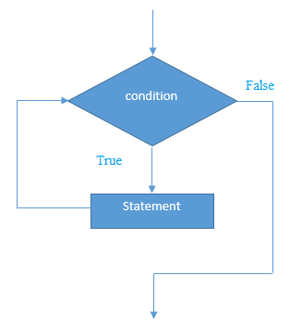
While Loop (Cont…)
S

Slide 6
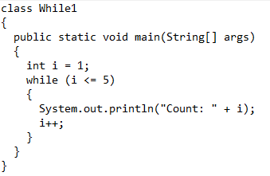
Simple Program using While Loop
S

Slide 7
Simple Program using While Loop (Cont…)
S
Output:
Count: 1
Count: 2
Count: 3
Count: 4
Count: 5

Slide 8
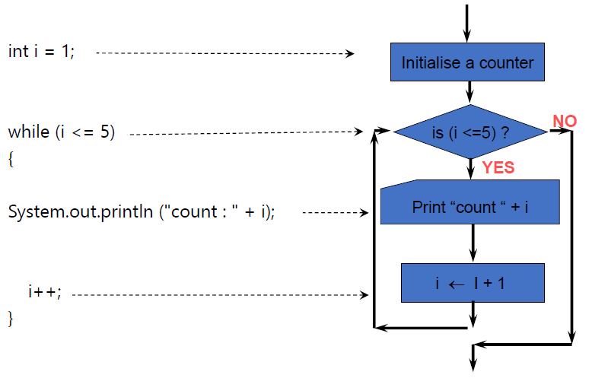
Simple Program using While Loop (Cont…)
S

Slide 9
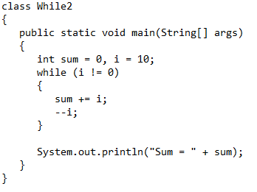
Simple Program using While Loop (Cont…)
S

Slide 10
Simple Program using While Loop (Cont…)
S
Output:
Sum = 55

Slide 11
Do-While Loop
S
Do-while loop is actually one kind of while loop.
This loop executes the lines or statements once before checking the condition. If the condition is true, it repeats the loop as long as the given condition is true.
Syntax:
do
{
statement 1;
statement 2;
}while(condition);

Slide 12
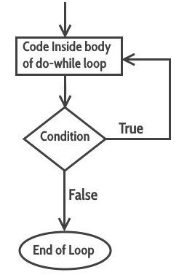
Do-While Loop (Cont…)
S

Slide 13
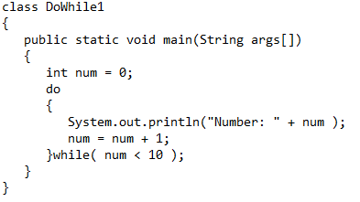
Simple Program using Do-While Loop
S

Slide 14
Simple Program using Do-While Loop (Cont…)
S
Output:
Number: 0
Number: 1
Number: 2
Number: 3
Number: 4
Number: 5
Number: 6
Number: 7
Number: 8
Number: 9

Slide 15
For Loop
S
For loop is concise version of while loop.
For loop is used, when we know exactly for how many times the code block will be executed.
There are mainly four parts in the entire for loop:
  Initialization
  Condition
  Increment/decrement
  Statement

Slide 16
For Loop (Cont…)
S
Syntax:
for(initialization; condition (Boolean Expression); increment/decrement)
{
statement 1;
statement 2;
}

Slide 17
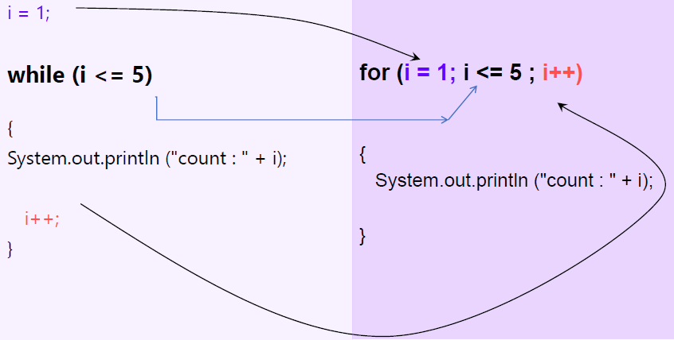
For Loop (Cont…)
S

Slide 18
For Loop (Cont…)
S
There is another way to write a for loop for an array (traverse).
It works on elements basis, not index basis.
Values of the array cannot be changed.
Syntax:
for (type variableName: arrayName)
{
Statement 1;
Statement 2;
}

Slide 19
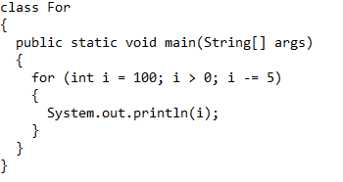
Simple Program using For Loop
S

Slide 20
Simple Program using For Loop (Cont…)
S
Output:
100
95
90
.
.
.
5

Slide 21
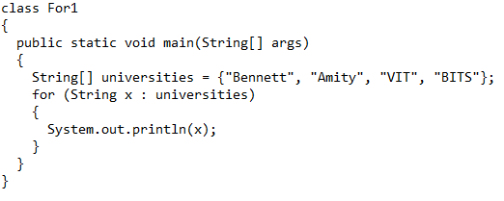
Simple Program using For Loop (Cont…)
S

Slide 22
Simple Program using For Loop (Cont…)
S
Output:
Bennett
Amity
VIT
BITS

Slide 23
Nested Loop
S
Similar to nested if/else statements, loops can be nested as well.
The body of a loop can contain another loop.
For each iteration of the outer loop, the inner loop iterates completely.

Slide 24
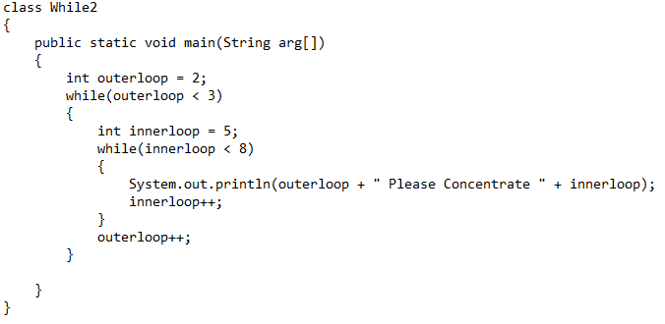
Simple Program using Nested Loop
S

Slide 25
Simple Program using Nested Loop (Cont…)
S
Output:
2 Please Concentrate 5
2 Please Concentrate 6
2 Please Concentrate 7

Slide 26
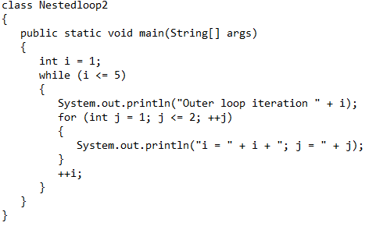
Simple Program using Nested Loop (Cont…)
S

Slide 27
Simple Program using Nested Loop (Cont…)
S
Output:
Outer loop iteration 1
i = 1; j = 1
i = 1; j = 2
Outer loop iteration 2
i = 2; j = 1
i = 2; j = 2
Outer loop iteration 3
i = 3; j = 1
i = 3; j = 2
Outer loop iteration 4
i = 4; j = 1
i = 4; j = 2
Outer loop iteration 5
i = 5; j = 1
i = 5; j = 2

Slide 28
Break and Continue in Loop
S
Break
  Terminates the loop or switch statement and transfers execution to the statement immediately following the loop or switch.
Continue
  Causes the loop to skip the reminder of its body and immediately retest its condition prior to reiterating.

Slide 29
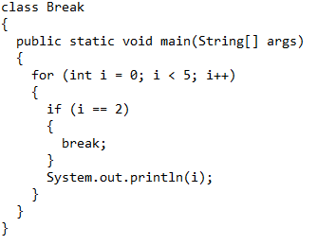
Program Using Break and Continue
S

Slide 30
Program Using Break and Continue (Cont…)
S
Output:
  0
  1

Slide 31
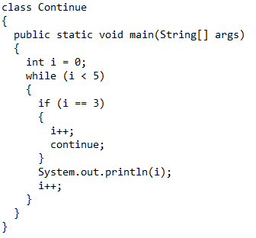
Program Using Break and Continue
S

Slide 32
Program Using Break and Continue (Cont…)
S
Output:
0
1
2
4

Slide 33
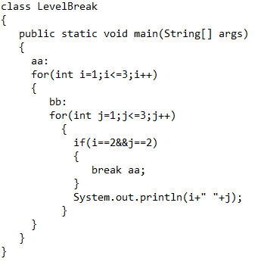
Program Using Break and Continue
S

Slide 34
Program Using Break and Continue (Cont…)
S
Output:
1 1
1 2
1 3
2 1

Slide 35




